Slide 1

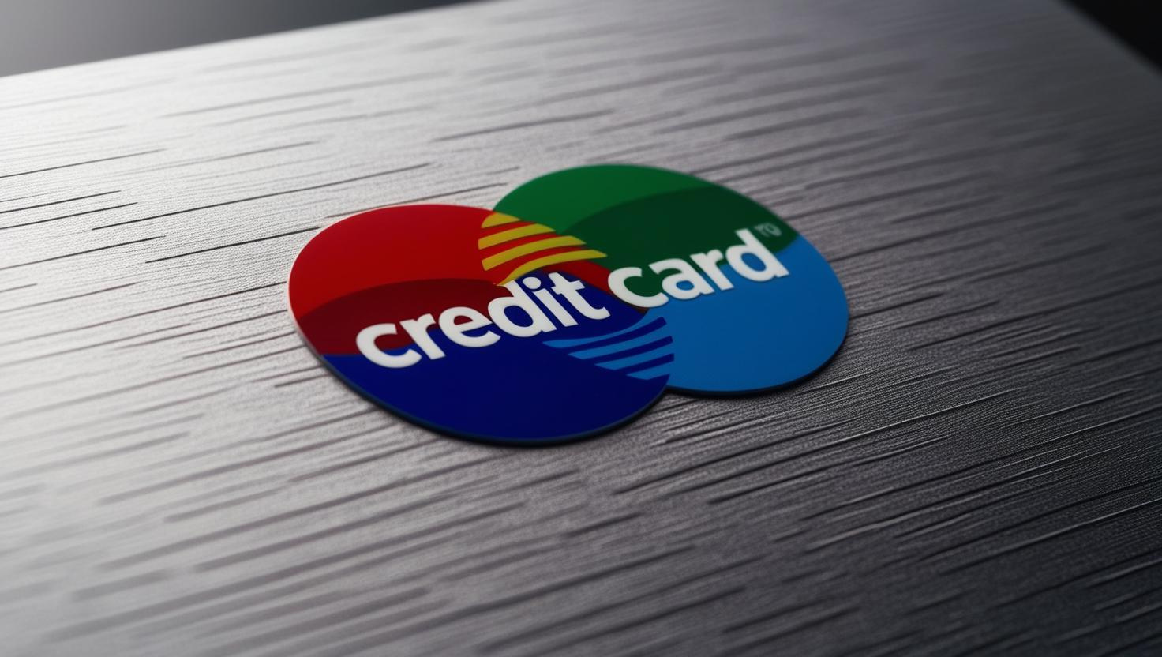

Credit Card Fraud Detection
SQL Analysis
Presented by Pijush

Slide 2
Contents
Introduction
Aim and Objective
General Overview of the Problem
Dataset Overview
SQL Queries Used
Fraud Detection Strategies
Recommendations for Fraud Prevention
Conclusion

Slide 3
INTRODUCTION
This data analysis aims to identify fraud in credit card transactions, identify trends, and understand fraud patterns.
SQL queries allow us to make informed conclusions from large groups of transactions and understand how and why fraud is occurring and which transactions are most vulnerable.
One of the main interests is to determine the total fraudulent purchases and their ratio of legitimate ones.
The research is intended to determine hotspots for frequent cases of fraud.
This data can be utilized to enhance fraud detection systems, enhance security, and reduce financial risks for banks and businesses.

Slide 4
AIMS AND OBJECTIVES
﻿
AIM:
To identify credit card transactions through SQL to identify fraudulent transactions based on transaction patterns, amounts, locations, and types.
OBJECTIVES :
Transaction Analysis – Identify trends, merchants, and anomalies.
Fraud Detection – Identify the suspicious transactions and evaluate risk.
Performance & Prevention – Measure accuracy and increase anti-fraud prevention.

Slide 5

General Overview of the Problem
Fraudulent Transactions – Identifying and analyzing patterns in fraudulent transactions to detect suspicious activities.
Transaction Trends – Understanding spending behavior, merchant usage, and location-based transaction trends.
Risk Assessment – Categorizing transactions into high-risk and low-risk to improve fraud detection strategies.
Data-Driven Prevention – Using SQL analysis to enhance fraud detection accuracy and minimize financial losses.

Slide 6
Dataset Overview
The dataset consists of transactions with the following fields:
- TransactionID: Unique identifier
- TransactionDate: Date & time of the transaction
- Amount: Transaction amount
- MerchantID: Merchant involved
- TransactionType: Purchase or refund
- Location: City where transaction occurred
- IsFraud: Indicator (1 = Fraud, 0 = Non-Fraud

Slide 7
SQL Queries Used
- Count total & fraudulent transactions
- Fraud distribution by transaction amount
- Total revenue and Fraudulent revenue
- Most affected countries
- Card numbers used for different locations within a short period.

Slide 8
Count total & fraudulent transactions
Monitoring overall and fraudulent transactions is critical in order to keep money safe from fraud.
The data set provided contains aggregated transaction information with two significant columns:
total_transactions: Number of transactions total (100,000).
fraud_transactions: number of fraudulent transactions (1,000).
SQL queries can be employed to segment transactions based on date, location, or type of payment to enable companies to detect patterns and prevent fraud.
Furthermore, determining the rate of fraud (fraud_transactions / total_transactions * 100) can tell us the proportion of risk transactions.

Slide 9
Count total & fraudulent transactions

Slide 10
Fraud distribution by transaction amount
Fraud transactions differ with transaction amount, and hence fraud distribution must be examined by various types of transactions.
The data set classifies transactions into three categories: High (>10,000): 899 fraudulent transactions Medium (100-1,000): 82 of fraudulent transactions Low (<100): 19 false transactions
In this category fraud cases by transaction amount, assisting in determining which range of transactions is most vulnerable to fraud.
SQL queries are used to analyze fraud patterns over time, detect anomalies, and associate fraud incidents with user behavior.

Slide 11
Fraud distribution by transaction amount

Slide 12
Total revenue and Fraudulent revenue
It is a comparison of total and fraud revenue based on SQL to evaluate the effect of fraud on earnings.
The database contains two key insights :
Total Revenue: $249,709,300. Fraudulent Revenue: $2,517,164.44
By import the data into SQL , which maintains the data integrity for data extraction and data cleaning.
Companies need to increase fraud detection mechanisms using detection techniques, transaction monitoring and AI-based fraud detection models to reduce losses.

Slide 13
Total revenue and Fraudulent revenue

Slide 14
Most Affected Countries
In data analysis, The MAX() function is used to determine the maximum fraud rate from the data in order to pinpoint the nation or area with the highest fraud rate.
Information on fraud rates in various regions is included in the data set. There are four columns in it:
Location:
fraud_count:
fraud_rate:
total_transactions:
According to the survey, out of all the locations mentioned, New York has the greatest fraud rate and is the most affected.
Because it warns stakeholders to be careful in creating strong security measures in vulnerable areas, this is essential for fraud detection and prevention.

Slide 15
Most Affected Countries

Slide 16
Card numbers used for different locations within a short period.
For fraud detection of the same card's use at more than one location at the earliest, we execute four crucial steps:
Data Cleaning: Clean the data set by deleting duplicates and errors.
Pattern Analysis: Group by card_number, sort by transaction_time, and calculate time differences using window functions like LEAD().
Suspicious Activity Detection: This detects when the same card is used in several locations within a short time frame (e.g., less than 30 minutes).
Insights and Action: Flag suspicious transactions for investigation to capture potential card theft or cloning.
This query identifies suspicious use of the same card at different locations in a short time, suggesting fraud.
Further analysis can reduce false positives and enhance the validity of fraud detection.

Slide 17
Card numbers used for different locations within a short period.
Location_1 & Time_1

Slide 18
Card numbers used for different locations within a short period.
Location_2 & Time_2

Slide 19
Fraud Detection Strategies
Carefully examine and monitor higher frequency transactions observed within short timescales.
Detect and flag transactions between different locations in a very short period of time.
Enact real-time fraud detection through machine learning algorithms.
Employ rule-based detection (e.g., high-risk merchant flagging).

Slide 20
Recommendations for Fraud Prevention
Implement real-time transaction monitoring.
Enhance authentication methods (e.g., OTP, biometrics).
Increase security for high-risk merchants.
Use AI/ML models for anomaly detection.
12

Slide 21
Conclusion
The project on credit card fraud detection applied SQL analysis in detecting suspicious activity and determining the risk. It detected that 1% of the total transactions were not valid, and those over $10,000 were most at risk. These led to a loss of about $2.5 million out of $249.7 million. The fraud in New York happened mostly, thus additional caution needed to be employed. Suspicious activity also involved using the same card at several locations within a short time frame. This is a sign of possible cloning or theft.
Real-time surveillance and advanced machine learning techniques can quickly identify suspicious behavior. Strengthening authentication for high-risk transactions is imperative to improving security and minimizing financial loss.

Slide 22
Thank you
14

